Slide 1
Capstone Project-1
Hotel Booking Analysis
Team Members
Piyush S Kutemate Prince Chauhan Mangal Lokhande Racky Kumar Jayesh Yadav

Slide 2
Table Of Contents
Problem Statement
Overview Of The Given Data And Problem
Steps Followed In Analysis
Understanding The Dataset Provided
Data Overview
Data Cleaning
EDA On Dataset
Univariate Analysis
Bivariate Analysis
Multivariate Analysis
Conclusions
Suggestions

Slide 3
Problem Statement:
Have you ever wondered when the best time of year to book a hotel room is? Or the optimal length of stay in order to get the best daily rate? What if you wanted to predict whether or not a hotel was likely to receive a disproportionately high number of special requests?
This hotel booking dataset can help you explore those questions!
This data set contains booking information for a city hotel and a resort hotel, and includes information such as when the booking was made, length of stay, the number of adults, children, and/or babies, and the number of available parking spaces, among other things.
All personally identifying information has been removed from the data. Explore and analyze the data to discover important factors that govern the bookings.

Slide 4
Overview of the given data and problem:
We are provided with hotel bookings dataset of the following years – 2015 to 2017
This dataset is unstructured, contains a lot of null values and needs cleansing.
Other than that , there are going to be certain data columns that we won't be needing so ﬁltering is required.
After proper Filtering and cleansing, We are going to analyse this dataset and try to gain insight and analyse factors that govern these bookings.
We will be using some libraries such as Numpy, Pandas and Matplotlib for different task such as managing arrays, working on dataframes and visualizing data.
We will be using data visualization to depict everything graphically.
.

Slide 5
Steps Followed In Analysis:
Data Collection
Exploratory
Data Analysis
Data Visualization
Data Cleaning
Data collection : We collected the hotel booking data on which EDA is to be done. We then understood the data, its columns/features and its content.
Data cleaning : We cleaned the data by dropping or replacing null values, deleting unwanted columns, checking data type and conversion to a data type of required column and we performed many other operations to get the required dataset.

Slide 6
Steps Followed In Analysis:
EDA will be divided into following analysis:
Univariate Analysis: Univariate analysis is the simplest of the three analysis where the data you are analyzing is only having one variable.
Bivariate analysis: In Bivariate analysis we will compare two variables to study their relationships.
Multivariate analysis: Multivariate analysis is similar to Bivariate analysis here we will compare more than two variables.

Slide 7
Understanding The Dataset Provided:
The data has 119390 rows and 32 columns or features. Now let’s understand what these columns have.
All columns heading and data description:
hotel : Hotel type.
is_canceled : booking is canceled or not (0 & 1).
lead_time : advance booking time
arrival_date_year : guests arrival year.
arrival_date_month : guests arrival month.
arrival_date_week_number : guests arrival week.
arrival_date_day_of_month : guests arrival day.
stays_in_weekend_nights : weekend nights bookings
stays_in_week_nights : weeknights bookings
adults : Number of adults.
children : number of children.
babies : Number of babies.
meal : Type of meals
country : Country of origin

Slide 8
Understanding The Dataset Provided: Continued-
market_segment : where the bookings came from.
distribution_channel : Booking distribution channel.
is_repeated_guest : repeated guest (1) yes or not (0).
previous_cancellations : previous bookings that were cancelled
previous_bookings_not_canceled : previous bookings that were not cancelled
reserved_room_type : Code of room type reserved.
assigned_room_type : Code for the type of room assigned to the booking
booking_changes : Number of changes/amendments made to the booking
deposit_type : Indication on if the customer made a deposit to guarantee the booking.
agent : ID of the travel agency that made the booking.
company : ID of the company/entity that made the booking
days_in_waiting_list : Number of days the booking was in the waiting list
customer_type : Type of booking, assuming one of four categories.
adr : Average Daily Rate
required_car_parking_spaces : Number of car parking spaces required to customer.
total_of_special_requests : Number of special requests
reservation_status : Reservation last status
reservation_status_date : Date at which the last status was set.

Slide 9
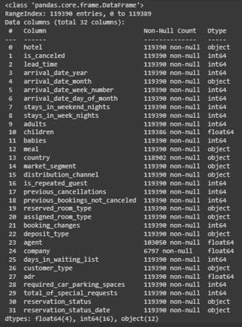
Data Overview:
We took a overview of the data together by using many methods such as .head() , .tail() , .describe(), shape , .info() and etc.

Slide 10
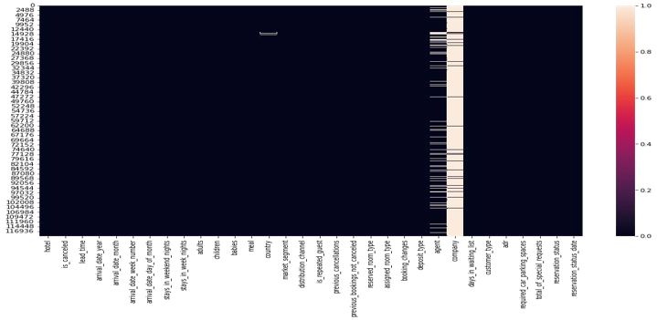
Data Cleaning:
Found null values in following columns and took actions accordingly
1. Children - replaced all missing 4 values with 0(int64).
2. Country - replaced all the missing values with “not mentioned”.
3. Company - Deleted the column as it was not useful.
4. Agent- Deleted the column as it was not useful.

Slide 11
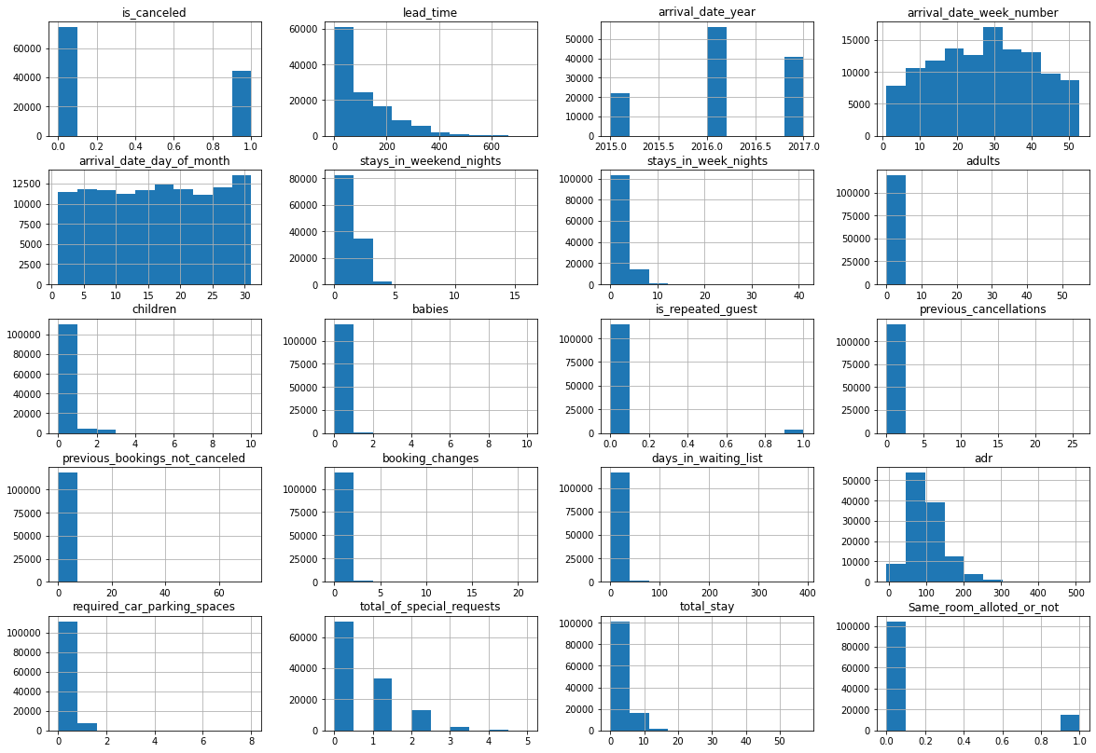
EDA on Dataset:
Brief of various column trends:
Before we start getting insights from data here are histograms to have a brief picture of various column trends and data.
All columns with data type int64 are represented in histograms

Slide 12
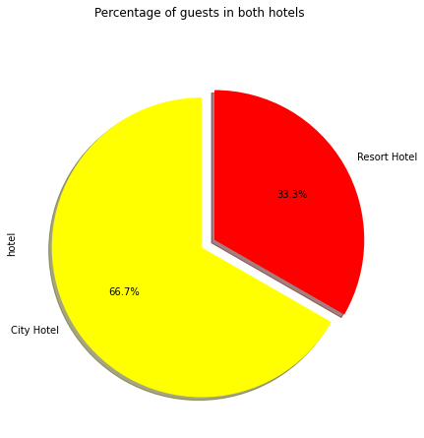
EDA- Univariate Analysis:
1. Most Preferred Hotel By The Guests-
Ratio of Booking
City Hotel is most preferred hotel by the guests having 66.7% weightage.
Resort Hotel is less preferred having 33.3% weightage.

Slide 13
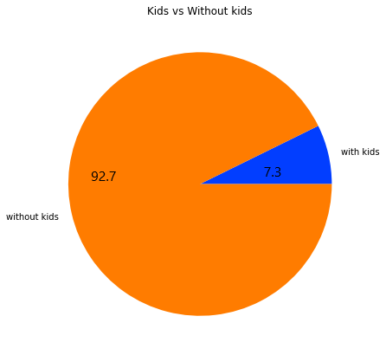
2. Adults Travelling with Kids Or without Kids-
Maximum Adults are traveling without any kids which are almost 92.7%.
Only 7.3% Adults are traveling with kids.

Slide 14
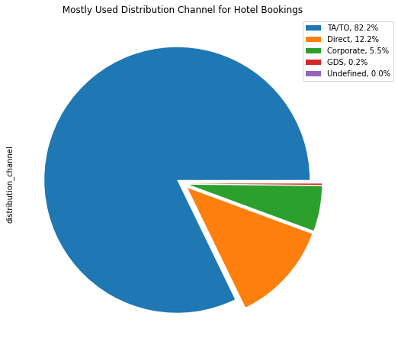
3. Most Preferred Distribution Channel For Hotel Booking-
82.2% booking were done from channel TA/TO(“TA” means “Travel Agents” and “TO” means “Tour Operators”).
2nd most preferred channel for booking is Direct booking.

Slide 15
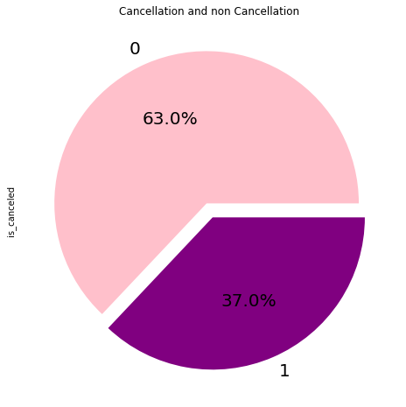
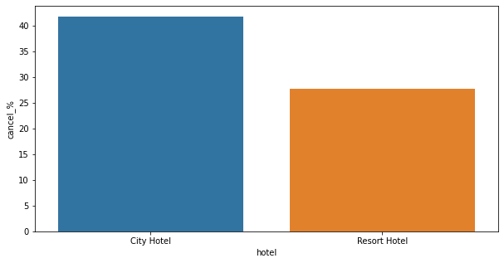
4. Hotel Booking Cancellation rate-
City Hotel Booking cancellation rate is 41.73%.
Resort Hotel Booking cancellation rate is 27.76%.
From above observation it is clear that City Hotel has higher cancellation rate.
0=cancelled, 1= not cancelled
Overall 37% bookings were cancelled

Slide 16
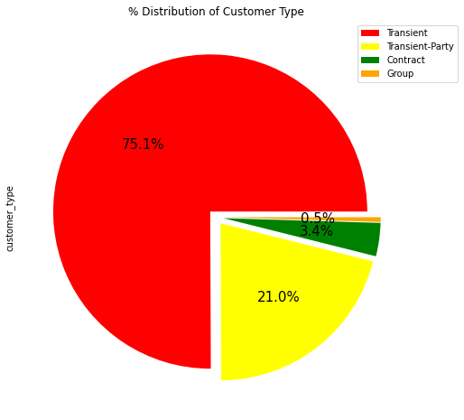
5. Distribution of Customer Type-
Contract:
When the booking has an allotment
or other type of contract associated to
it.
Group:
When the booking is associated to a
. group.
Transient:
When the booking is not part of a
group or contract , and is not
associated to other transient booking.
Transient-Party:
When the booking is transient, but is
associated to at least other transient
booking.
From Above Graph it is clear that Transient customer type is more which is 75% .
Percentage of Booking associated by the group is very low.

Slide 17
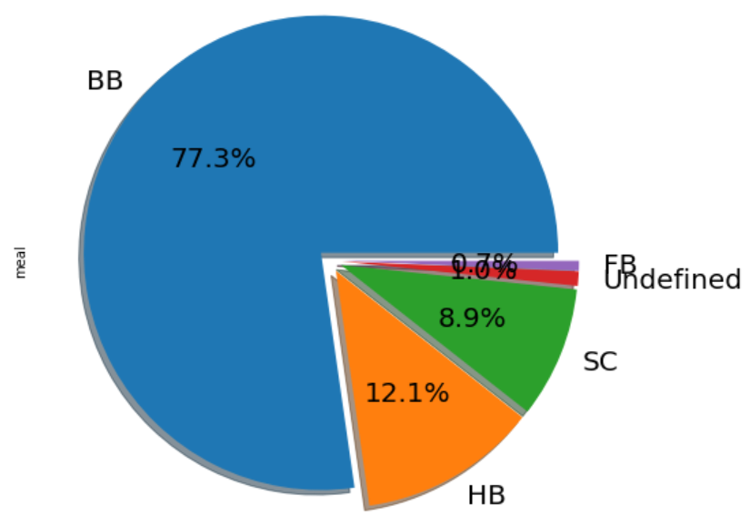
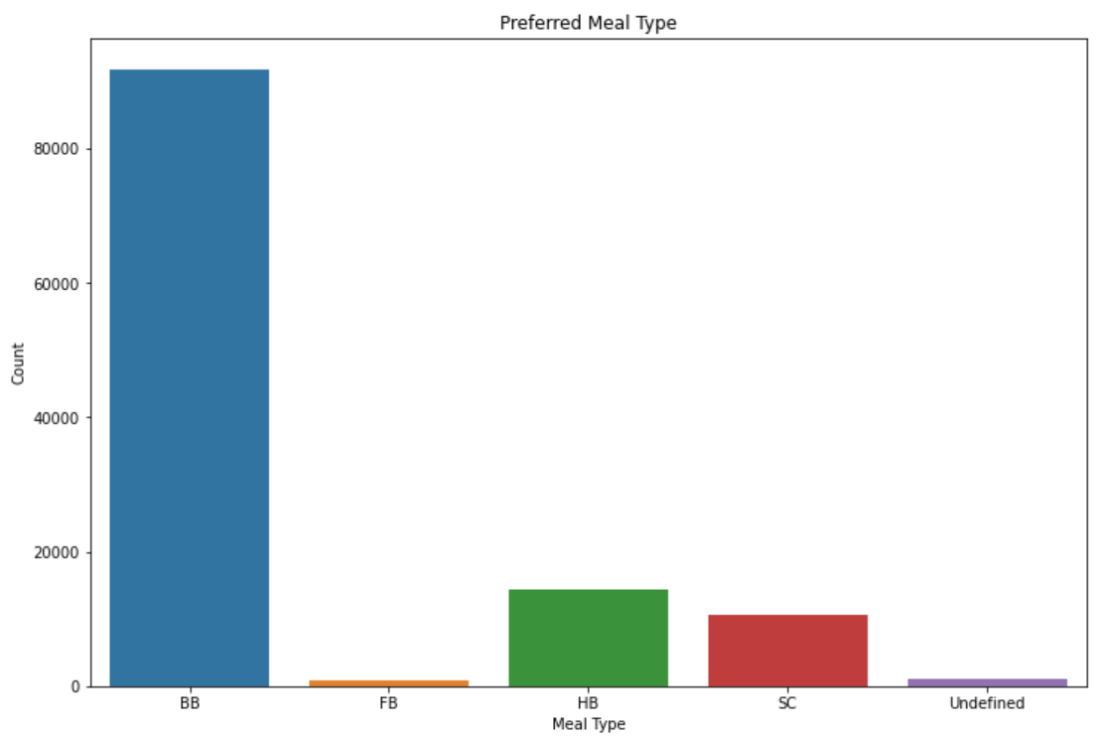
6. Meal Preference-
Types of meal in hotels:
BB - (Bed and Breakfast), HB- (Half Board), FB- (Full Board), SC- (Self Catering)
Most preferred meal type by the guests is BB( Bed and Breakfast),
HB- (Half Board) and SC- (Self Catering) are equally preferred.

Slide 18
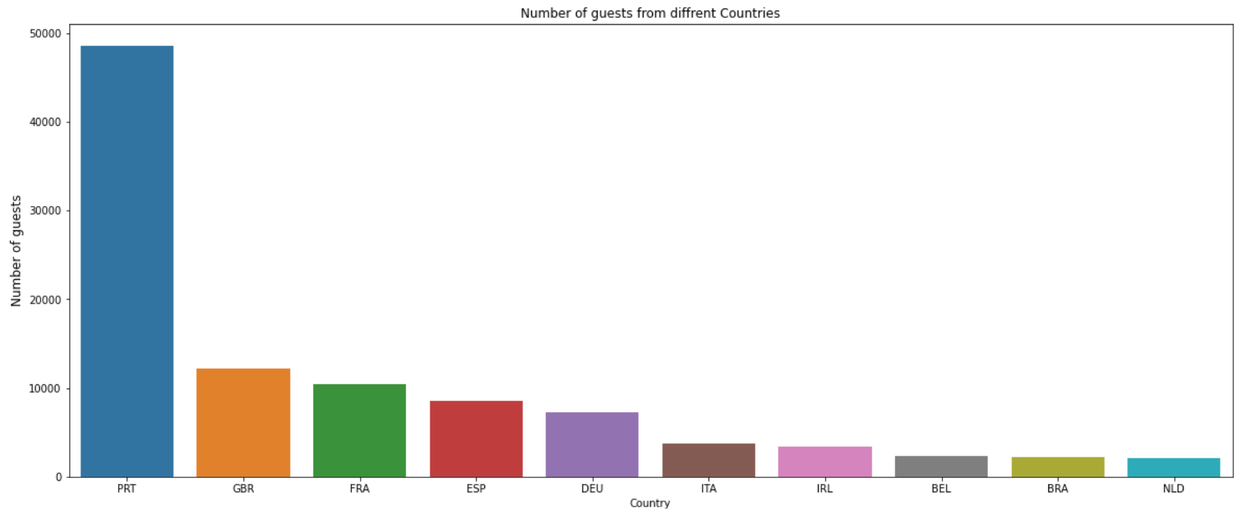
7. Top 10 Countries-
PRT- Portugal
GBR- United Kingdom
FRA- France
ESP- Spain
DEU- Germany
ITA- Italy
IRL- Ireland
BEL- Belgium
BRA- Brazil
NLD- Netherlands
Most of the guests are coming from Portugal i.e. 4800 guests.

Slide 19
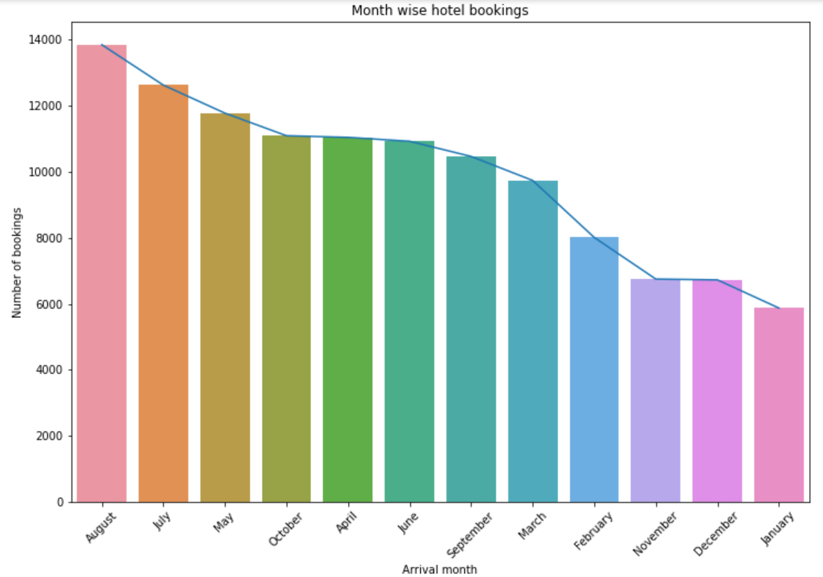
Bivariate Analysis:
1. Most Bookings in Month-
July and August months had the highest number of Bookings.
Summer vacation can be the reason for the bookings.

Slide 20
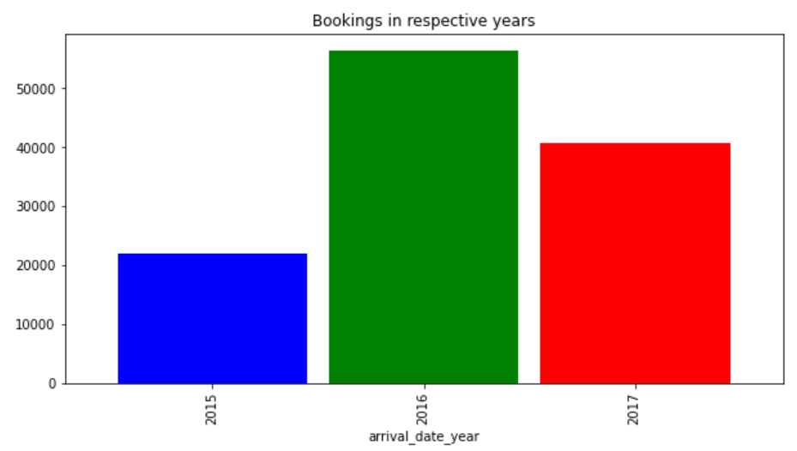
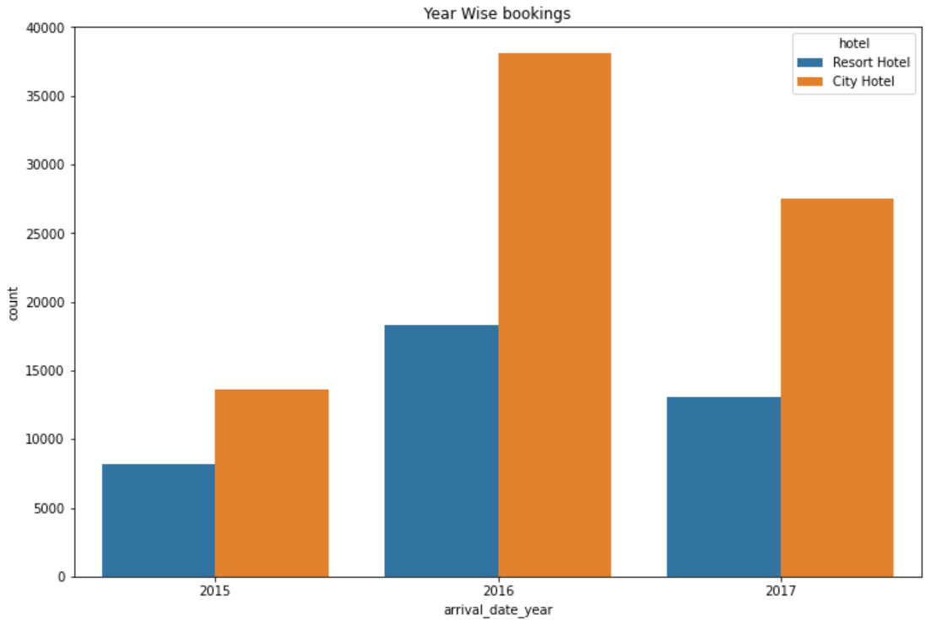
2. Highest Bookings in Hotel/Year-
2016 had the highest bookings.
2015 had the lowest bookings.
Overall City hotels had the most of the bookings.

Slide 21
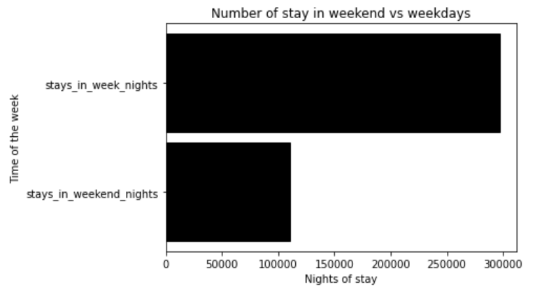
3. Highest Stays in Week or Weekend Nights-
297499 stays days were booked on weekdays and only 110444 stays days were booked on weekends.
Guests Stays more in week nights than weekend nights

Slide 22
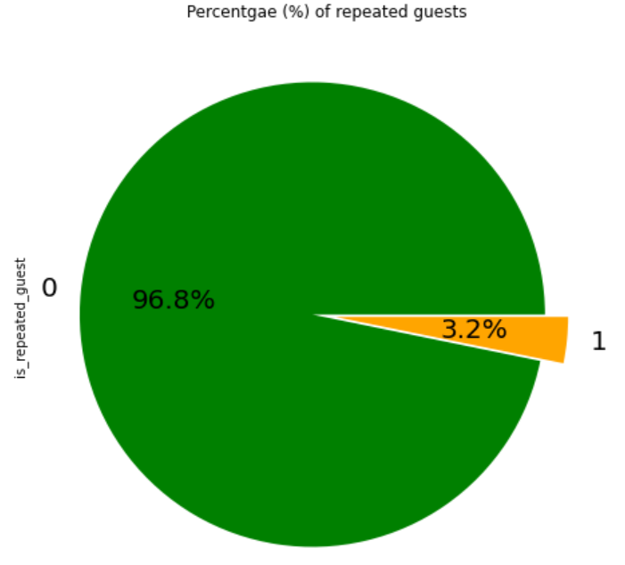
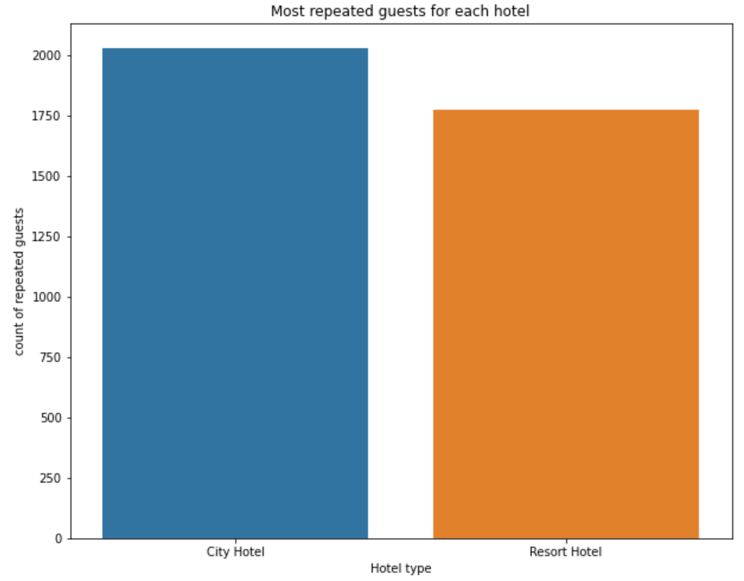
4. Hotel with Repeated Guest-
Resort Hotel has slightly more repeated guests than the City Hotels.
It is almost similar for both hotels.
Overall repeated guests are very few which only 3.2 %.
In order to retained the guests, management should take feedbacks from guests and try to improve the services

Slide 23
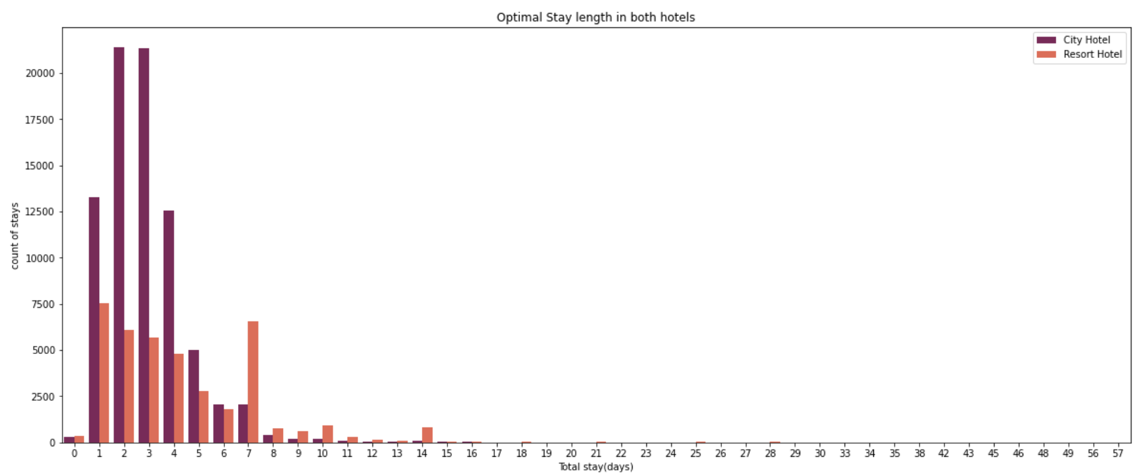
5. Optimal Stay Length in Hotels-
Optimal stay length in both hotels is less than 7 days usually people stays for a week.
For stay more than 7 days people like to stay in Resort hotel as we can see after 7 days city hotel booking are very less as compared to Resort hotel.
On an average customer preferred to stay 1 to 4 days.

Slide 24
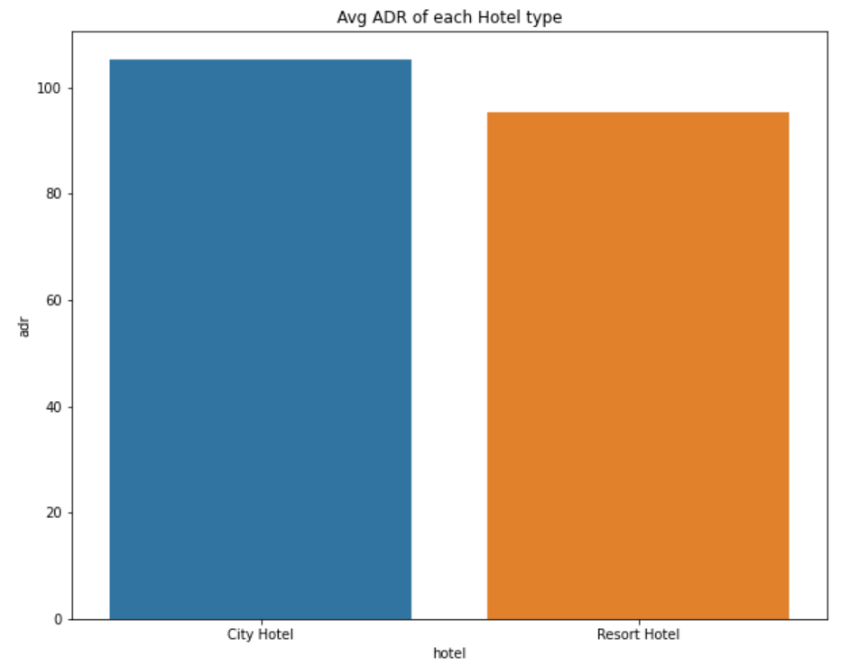
6. Hotel having highest ADR-
City hotel having highest ADR that means city hotels are generating more revenues than the resort hotels.
More the ADR more is the revenue.
ADR- Average Daily Rate

Slide 25
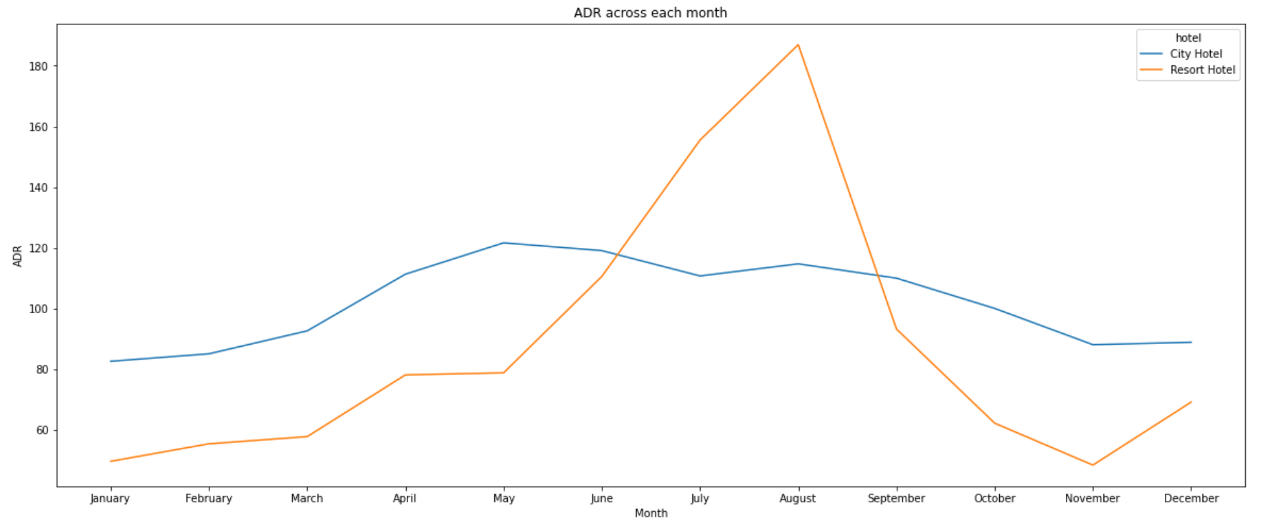
7. Hotel generating more Revenue-
For Resort hotel is ADR is high in the months June, July, August as compared to City Hotels. May be Customers/People wants to spend their Summer vacation in Resorts Hotels.
The best time for guests to visit Resort or City hotels is January, February, March, April, October, November and December as the average daily rate in this month is very low.

Slide 26
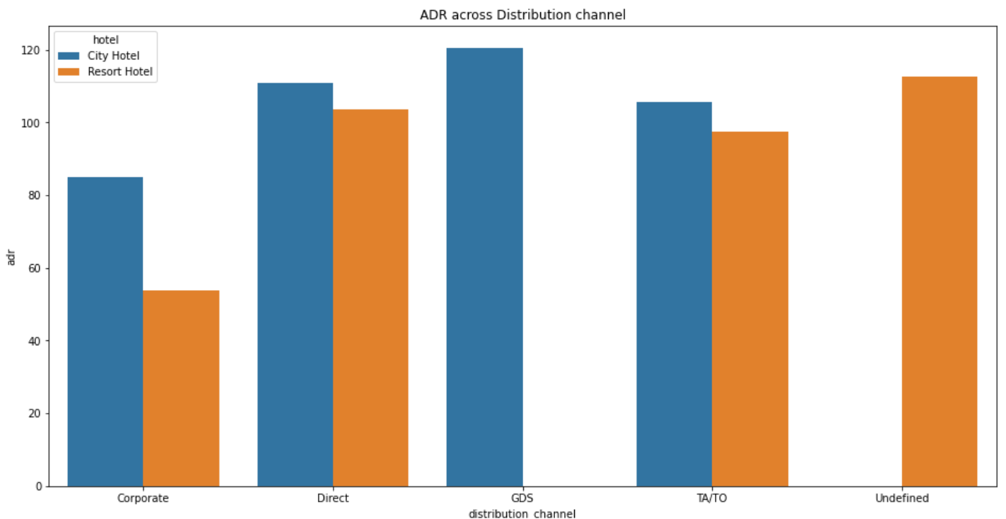
8. Distribution channel contributed in Income-
'Direct' and 'TA/TO' has almost equally contributed in ADR in both type of hotels i.e. 'City Hotel' and 'Resort Hotel’.
GDS has highly contributed in ADR in 'City Hotel' type.
GDS needs to increase Resort Hotel bookings.

Slide 27
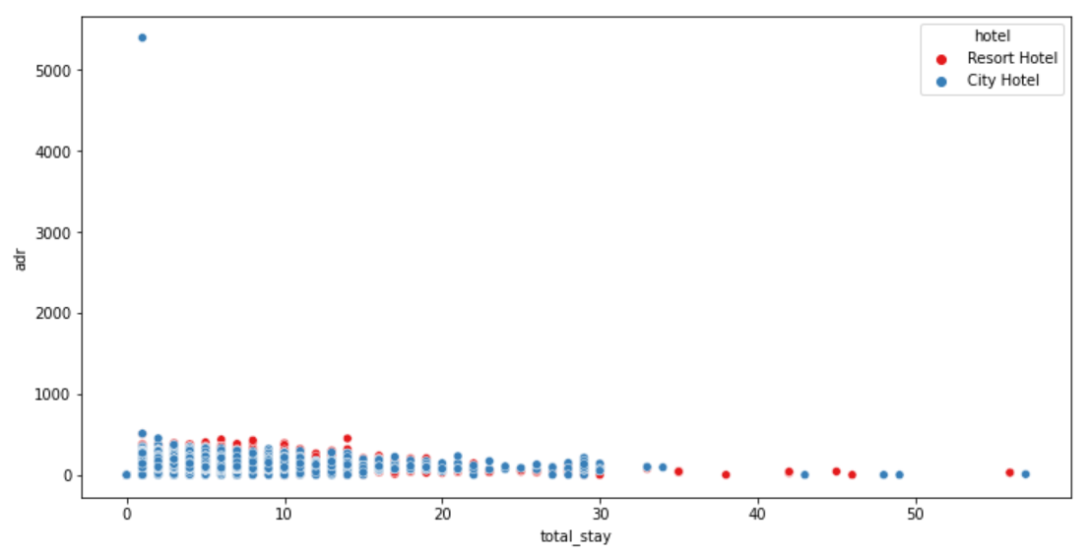
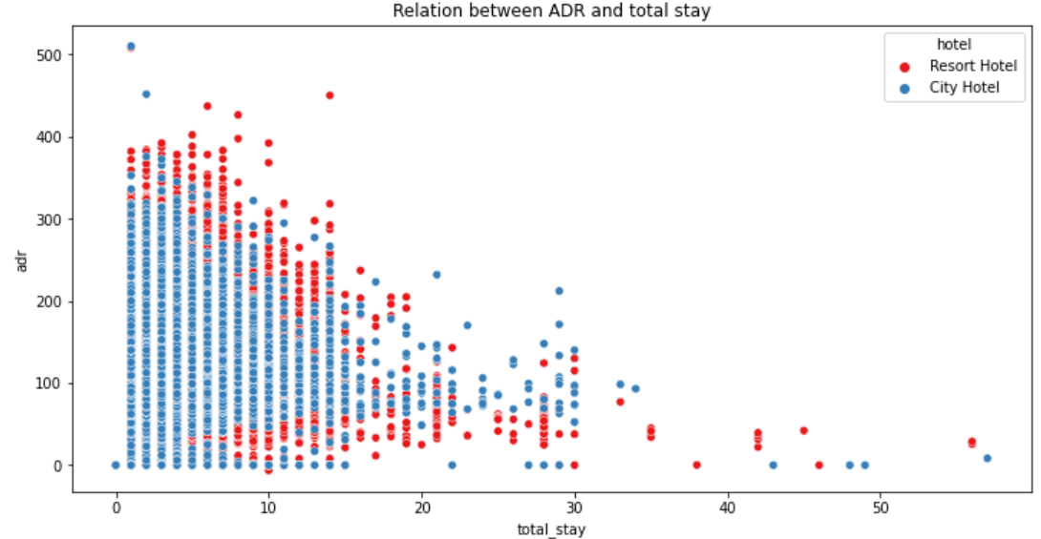
9. ADR affected by length of Stay-
As the total stay increases the ADR(Average Daily Rate) Decreases.

Slide 28
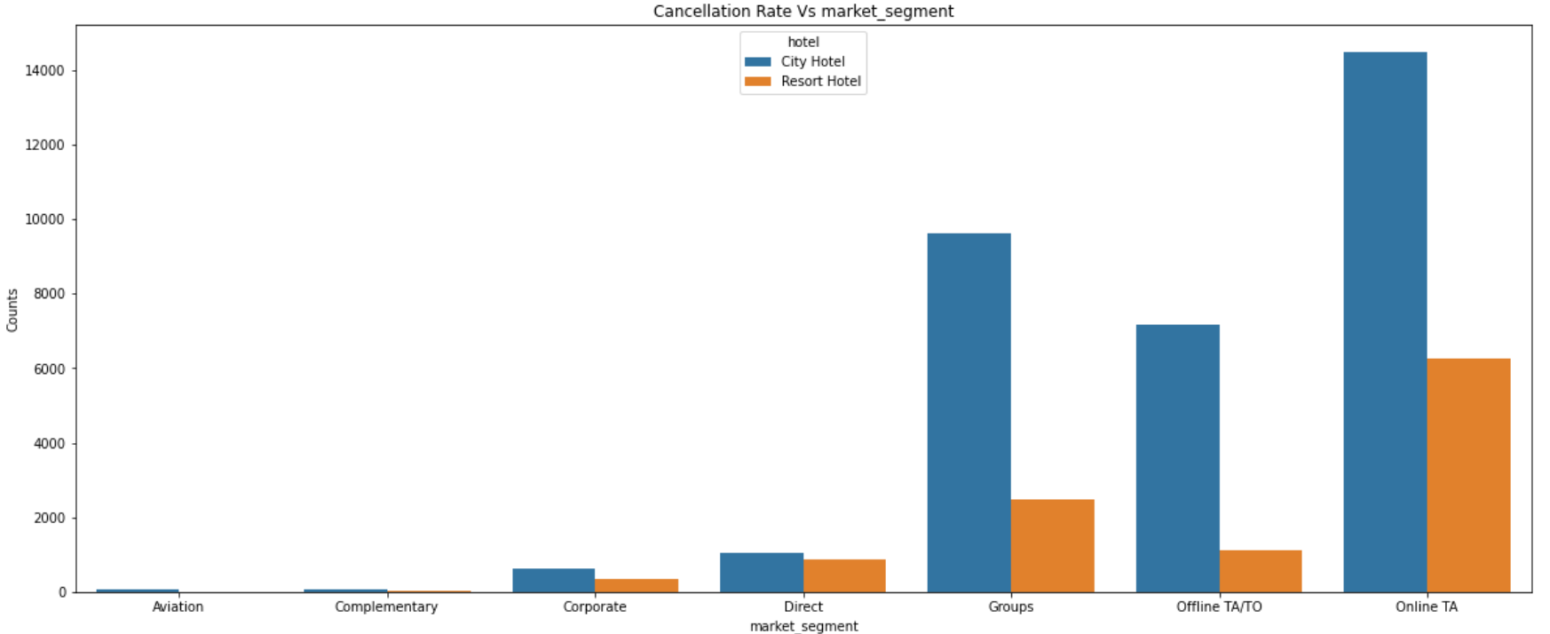
10. Market Segment with Highest Cancellation Rate-
'Online T/A' has the highest cancellation in both type of cities.
In order to reduce the booking cancellations hotels need to set the refundable/ no refundable and deposit policies.

Slide 29
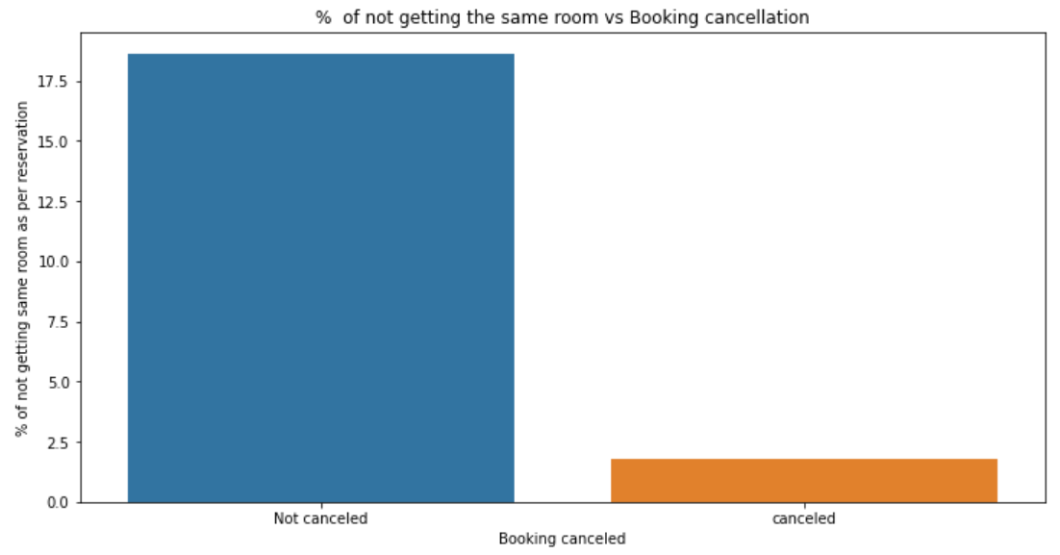
11. Allotment of Room type as Reserved-
There's not much effect on cancellation of the bookings even if the guests are not assigned with rooms which they reserved during booking.

Slide 30
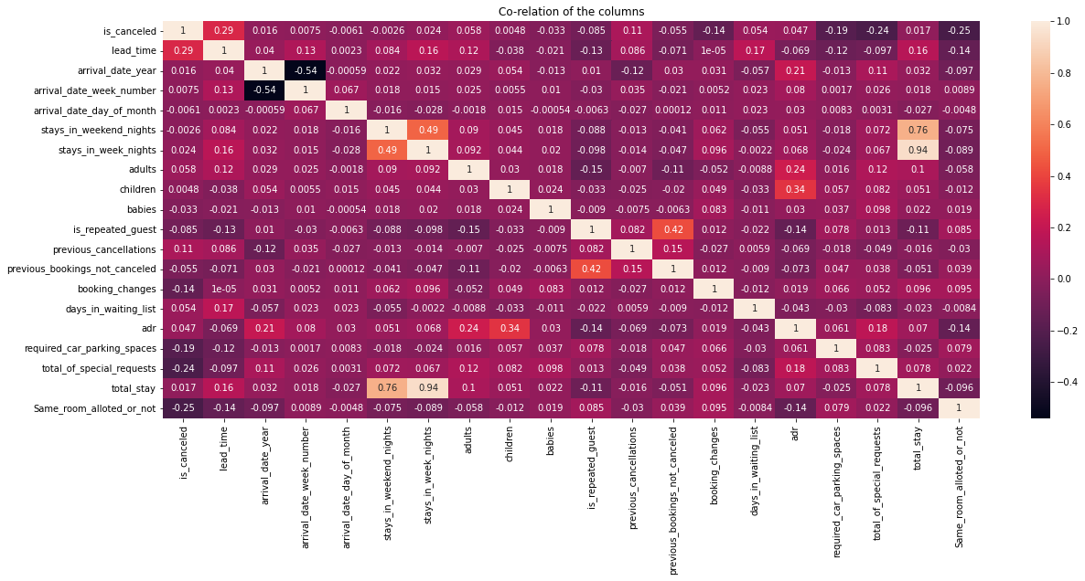
1. Correlation heatmap of data-
EDA-Multivariate Analysis:

Slide 31
1. Correlation heatmap of data- Continued-
ADR(Average Daily Rate) and guests with children have slight positive correlation. which means more the kids, more is the ADR.
Total stay and lead time have positive correlation.
Adr(Average Daily Rate) is positively correlated with total guests. Which states more the guest will generate more ADR
Repeated guests and previous bookings not canceled has strong positive correlation. Repeated guests are more likely to not cancel their bookings.
Company and agents are slightly more correlated
Stays in week night and total stay are positively correlated, even more than
weekend nights which says, longer stays are in week time only.
Lead time and total stay are positively correlated. That means more is the stay of customer more will be the lead time.
Adults, children, Babies, total stay and ADR has positive correlation which means more the people, longer the stay which will hike ADR.

Slide 32
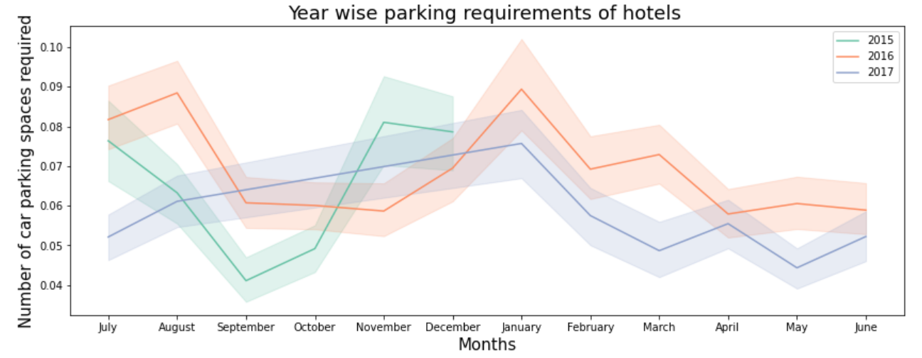
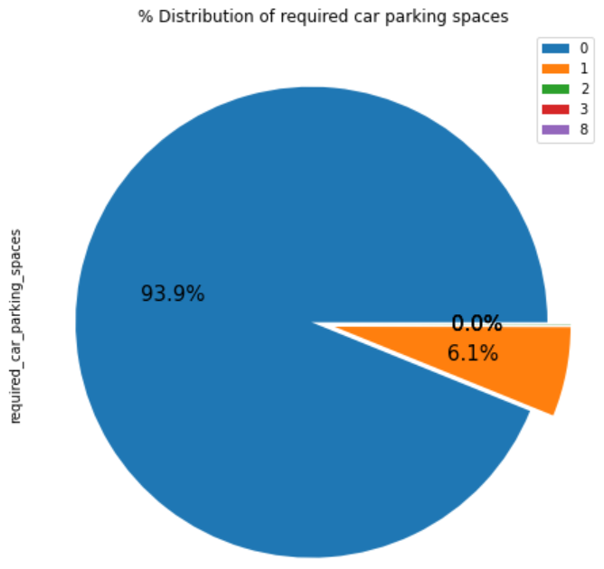
2. Car Parking Space-
In year 2016 January months required highest number of car parking space.
In year 2015 September month required lowest number of parking space.
Overall 93.9 % guests did not required the parking space.
6.1 % guests required only 1 parking space.

Slide 33
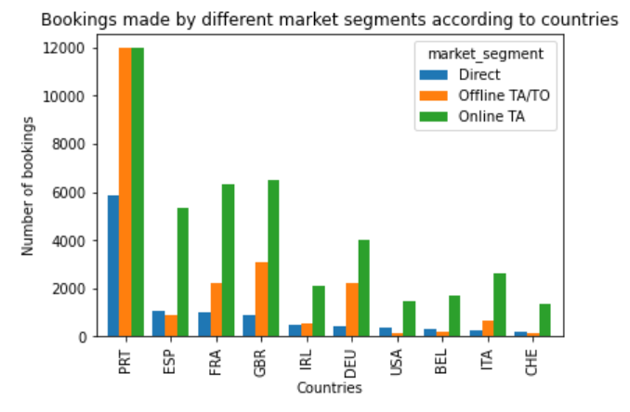
3. Number of Bookings from Different Countries-
On average 'Online TA' is the most preferred channel and on average least preferred is 'Direct' channel.
Maximum bookings are from Portugal country, followed by country GRB(United kingdom)

Slide 34
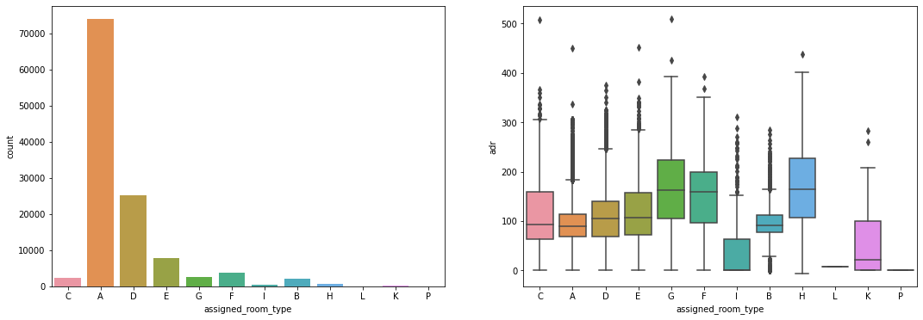
4. Plotting in demand room and which room generate more ADR-
We can see that 'A' type room is most in demand but on contrary room type 'H', 'G' and 'F' are most ADR generating rooms respectively

Slide 35
Conclusion:
After careful analysis, we can conclude that the hotel industry can beneﬁt a lot by studying the type of customers, their booking mode, the booking month and the seasons.
The hotel industry market, their ADR and bookings are based on the type of customers, the month, types of meal, hotel type ,their country of origin, Room types, booking medium and many others.

Slide 36
Suggestions:
The hotel industry can take the advantage of seasons and months as ADR was highest in august (rainy season).
Most customers booked rooms online so they can be targeted with proper seasonal discounts and vacay-ads.
Since ADR was least during Nov and Jan, winter discounts(assumption) or off season discounts might help.
For retention, they should introduce Portuguese meals(sea foods and meat) and Eastern European meals as guests are more from there.
They should encourage direct bookings by offering some special discounts as online bookings cancellation is high.
Since room A is booked more, they should take into account the factors how it is different from other rooms and implement the same in other rooms as well.
Since resort hotels are less preferred, they should look into the factors- might be High cost or guests requirements.

Slide 37
Thank You

